Slide 1
M.TECH DATA SCIENCE & AI — FINAL THESIS REVIEW
Tinker RL Lab
A Multi-Framework Benchmark and Study of GRPO-Style Reinforcement-Learning Post-Training of Large Language Models
Arvind C R (Arvind Chitra Rajasekaran)
SRN: PES2PGE24DS140
Project Guide: Ramesh Prakash Guledgudd
Department of Computer Science & Engineering
PES University, Bengaluru
July 2026

Slide 2
Agenda
1. Problem statement & motivation
2. Objectives
3. Literature context (RLHF → PPO → DPO → GRPO)
4. System architecture (6 RL frameworks)
5. Methodology: the four de-confound pillars
6. Key results (5 slides)
7. P1–P8 contribution map
8. Applied study: LLM vs XGBoost fraud
9. Reproducibility & audit apparatus
10. Publications & submissions
11. Demo, ownership, limitations
12. Conclusions & Q&A
Tinker RL Lab — M.Tech Final Thesis Review • Arvind C R
2

Slide 3
Problem Statement & Motivation
GRPO (critic-free, group-relative RL) is now the default for LLM post-training — but its reported gains are easily confounded.
A headline number hides the stack: same nominal “GRPO” gives TRL 73.4% vs Tinker 99.9% on the same task (p=0.0014).
Most published RL-for-LLM results are single-seed, single-library, and train-set-only — not auditable or comparable.
Does GRPO actually add capability, or surface pre-existing capability? On held-out GSM8K, GRPO adds only +1.3 pts over the base model (83.3% vs 82.0%, p=0.26).
Need: an honest, multi-framework harness that runs identical GRPO/PPO/DPO workloads and isolates what actually drives the effect.
Sources: LIMITATIONS_AND_IMPACT.md §8; reports/final/ held-out eval; experiments/experiment_summary.md
Tinker RL Lab — M.Tech Final Thesis Review • Arvind C R
3

Slide 4
Objectives
O1 Build a multi-framework benchmark that runs identical GRPO/PPO/DPO workloads across Tinker, SkyRL, verl, OpenRLHF, TRL and Atropos.
O2 De-confound the GRPO effect via four controlled pillars (same-stack algorithm, ZVF, group size, held-out generalization).
O3 Introduce diagnostics for signal starvation — the Zero-Variance Fraction (ZVF) and gradient utilization = 1−ZVF.
O4 Characterize GRPO scaling behavior from 0.6B to ~671B parameters across five model families.
O5 Enforce reproducibility: multi-seed protocol, 13-audit integrity suite, Docker, and copy-pasteable REPRODUCE.md.
O6 Probe transfer of the measurement discipline to an applied domain (LLM vs XGBoost credit-card fraud).
Tinker RL Lab — M.Tech Final Thesis Review • Arvind C R
4

Slide 5
ALGORITHMIC LINEAGE
Literature Context
Method | Key idea | Reference
RLHF / InstructGPT | Align LMs to human preference via a learned reward + RL | Ouyang et al. 2022
PPO | Clipped policy-gradient with a value critic (the RLHF workhorse) | Schulman et al. 2017
DPO | Skip the reward model: preference as a closed-form classification loss | Rafailov et al. 2023
GRPO | Critic-free; group-relative baseline over G sampled completions | Shao et al. 2024 (DeepSeekMath)
R1-style RL | GRPO at scale elicits emergent chain-of-thought reasoning | DeepSeek-R1, 2025
This work studies the GRPO node of this lineage: critic-free RL removes the value network but introduces group-relative variance as the new failure surface (Pillars 1–2).
Source: capstone-literature-survey/chapter2_foundation.tex, references.bib
Tinker RL Lab — M.Tech Final Thesis Review • Arvind C R
5

Slide 6
MULTI-FRAMEWORK BENCHMARK
System Architecture
Six RL backends behind one Tinker-style API
Unified pipeline
unified.launcher → dispatch to any backend
Envs: GSM8K, MATH-500, HumanEval, xLAM / synthetic tool-use
Models: Qwen 0.6B–235B, Llama-3.1-8B, DeepSeek-V3.1, Nemotron-120B
Telemetry: per-step reward, ZVF, gradient norm, length
Aggregate → rliable + bootstrap → LaTeX tables + figures
Held-out evaluator + 9 variance-mitigation baselines
Tinker — managed GRPO/PPO/REINFORCE (hosted API)
SkyRL tx — local Tinker API on own / vast.ai / Colab GPUs
verl — Volcano Engine / HybridFlow, Ray + vLLM
OpenRLHF — Ray + vLLM; PPO / DAPO / REINFORCE++
TRL — HuggingFace reference same-stack runner
Atropos — NousResearch RL environments (GSM8K/MATH/tool-use)
Backends span Local GPU, vast.ai, Modal H100 and Colab.
Tinker RL Lab — M.Tech Final Thesis Review • Arvind C R
6

Slide 7
Methodology: The Four De-Confound Pillars
Pillar | What it isolates | Design
1 · PPO vs GRPO (same-stack) | Only the advantage estimator differs | Identical model / data / stack
2 · Zero-Variance Fraction | Measured signal starvation + confounders | Per-step ZVF across 9 libraries
3 · Trainability / group size | Preference density vs variance knob | G ∈ {2,4,8,16} × seeds, held-out
4 · Held-out generalization | Does GRPO add real capability? | Dr.GRPO vs GRPO, pre→post, McNemar
Each pillar holds the whole stack fixed and varies exactly one factor — so a difference cannot be blamed on the framework. Scripts: experiments/modal/.
Tinker RL Lab — M.Tech Final Thesis Review • Arvind C R
7

Slide 8
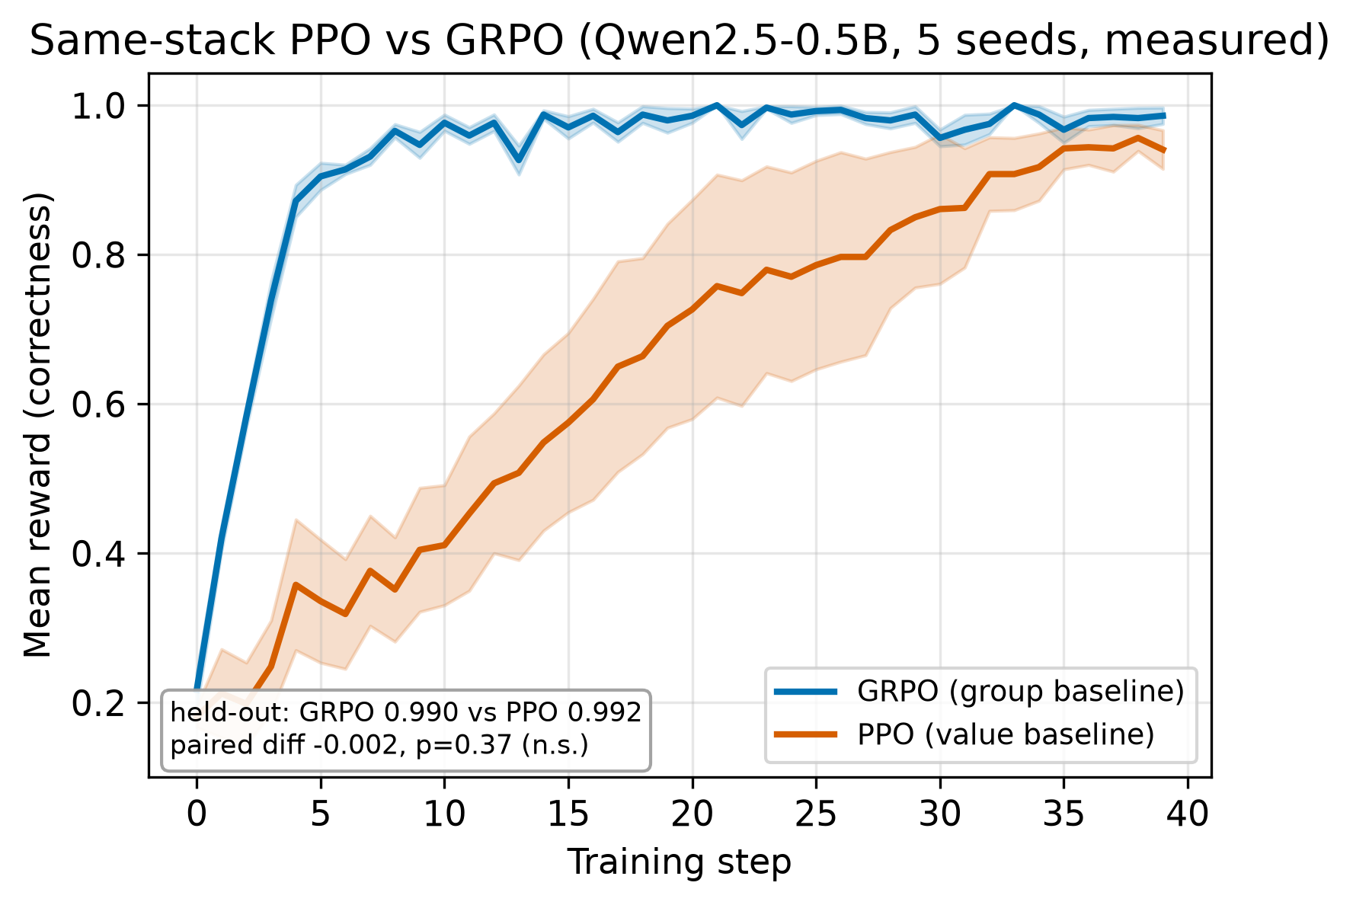
PILLAR 1
Result 1 — Same-Stack PPO vs GRPO
Same stack, only the estimator differs: PPO and GRPO are statistically indistinguishable.
Welch t-test p = 0.7605; paired Δ = −0.002, p = 0.374.
The advantage of “GRPO” in the wild is model-dependent, not universal:
Qwen3-8B: GRPO 34.4% vs PPO 22.5% last-10 (GRPO +11.9 pp)
Llama-3.1-8B-Instruct: GRPO 84.4% vs PPO 97.5% (PPO +13.1 pp)
Takeaway: report the stack, not the label — there is no universally superior algorithm at these scales.
PPO vs GRPO across models (paper/figures/v2/)
Source: experiment_summary.md; _shared_methods.tex row 20; frontier_synthesis_scaling.tex
Tinker RL Lab — M.Tech Final Thesis Review • Arvind C R
8

Slide 9
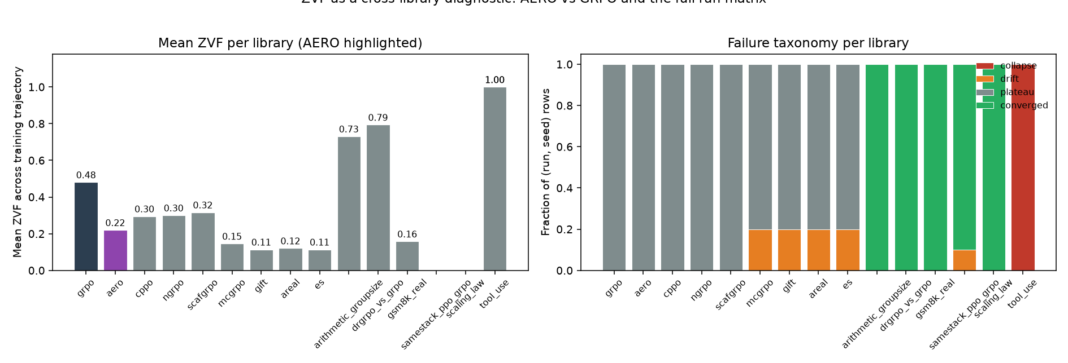
PILLAR 2
Result 2 — Zero-Variance Fraction Diagnostic
ZVF = fraction of rollout groups where all G completions get identical reward → zero gradient. Gradient utilization = 1 − ZVF.
Vanilla GRPO wastes ~half its rollouts: mean ZVF 0.481.
AERO halves it to 0.220 and is the only mitigation that keeps vanilla's last-10 accuracy (0.399 vs 0.379).
Aggregated over N=80 (experiment, condition, seed) rows on one managed runtime — identical reward parser, β=0 KL, template.
ZVF is a descriptive early-warning signal for signal starvation, portable across libraries.
Mean ZVF per library (paper/figures/)
Source: paper/sections/zvf.tex, experiments/results/zvf_by_library.tsv
Tinker RL Lab — M.Tech Final Thesis Review • Arvind C R
9

Slide 10
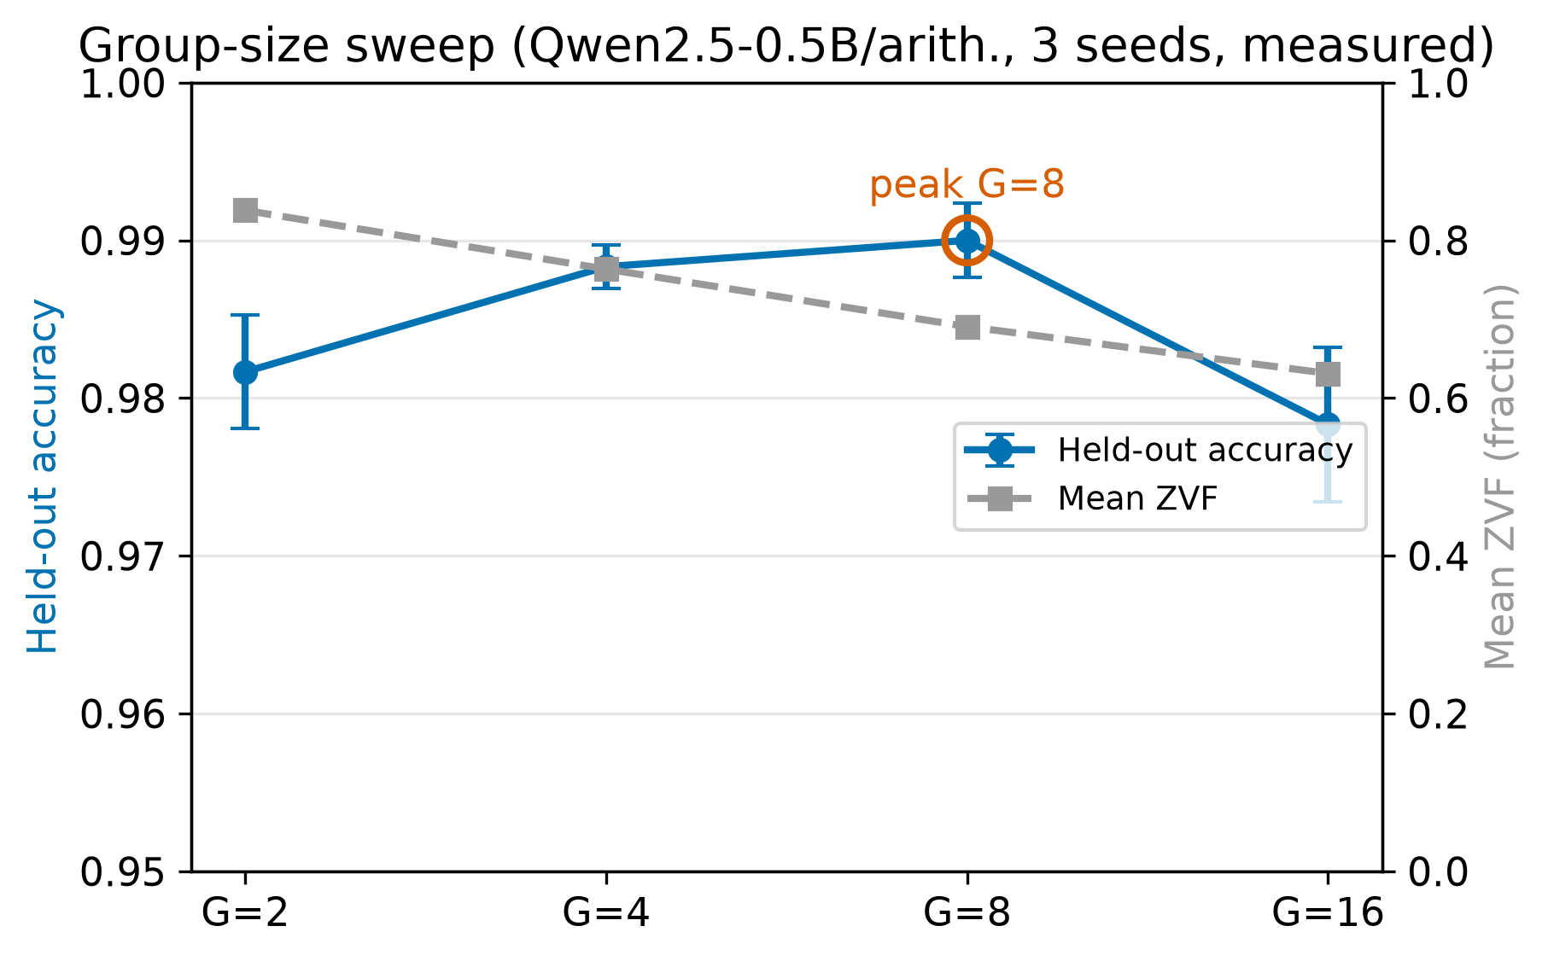
PILLAR 3
Result 3 — Group Size & Trainability
G | Peak | Last-10
2 | 50.0% | 37.5%
4 | 75.0% | 52.1%
8 | 100% | 84.4%
16 | 71.9% | 38.0%
Trainability is non-monotone in G — intermediate sizes beat the smallest and largest tested; no universal optimum.
Effective signal-to-noise rises only sublinearly: ~52% of the √G ideal.
On the near-ceiling task, held-out accuracy is flat G=2→G=16 (retention ratio ≈ 1.00) — a saturated-regime null, not equivalence on hard tasks.
Framing: G is a preference-density dial (an implicit all-pairs / DPO-like contrast), not merely a variance knob.
Table: REPRODUCE.md §4.1 (paper Table 2, group-size block).
Group-size ablation (paper/figures/v2/)
Source: REPRODUCE.md §4.1; paper/sections/p3_abstract.tex
Tinker RL Lab — M.Tech Final Thesis Review • Arvind C R
10

Slide 11
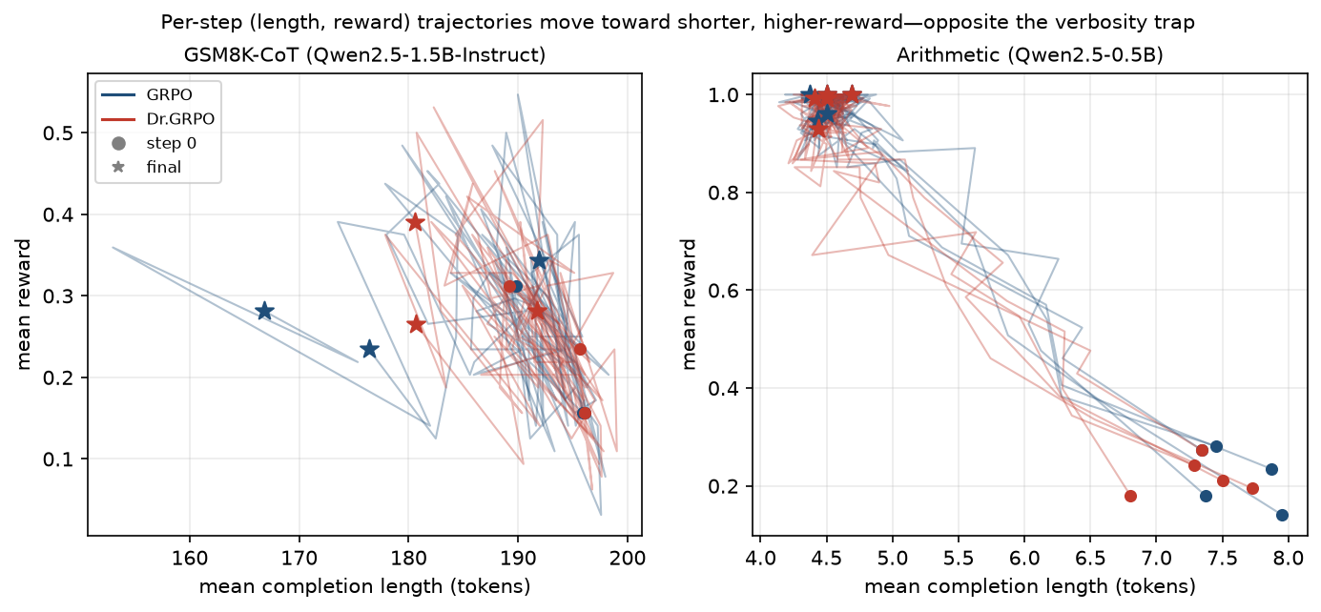
PILLAR 4
Result 4 — Length Bias & Held-Out Generalization
Length bias (verbosity trap): 4 of 11 GRPO runs peak before 65% of training then decay — optimizing length, not correctness.
Dr.GRPO is the only algorithm whose length keeps a negative slope (diff −0.0028, 95% CI [−0.0045, −0.0014]).
Held-out GSM8K (Qwen3-8B, 5 seeds × 200 test items, greedy):
GRPO 83.3% (SD 2.2%) vs base 82.0% — only +1.3 pp
t = 1.32, p = 0.26 → not significant; capability is pre-existing
Honest negative: GRPO surfaces capability more than it creates it.
Length vs reward coupling (paper/figures/)
Source: reports/final/ held-out eval (grpo_agentic_llm_paper.tex); length_bias_iter48.tex
Tinker RL Lab — M.Tech Final Thesis Review • Arvind C R
11

Slide 12
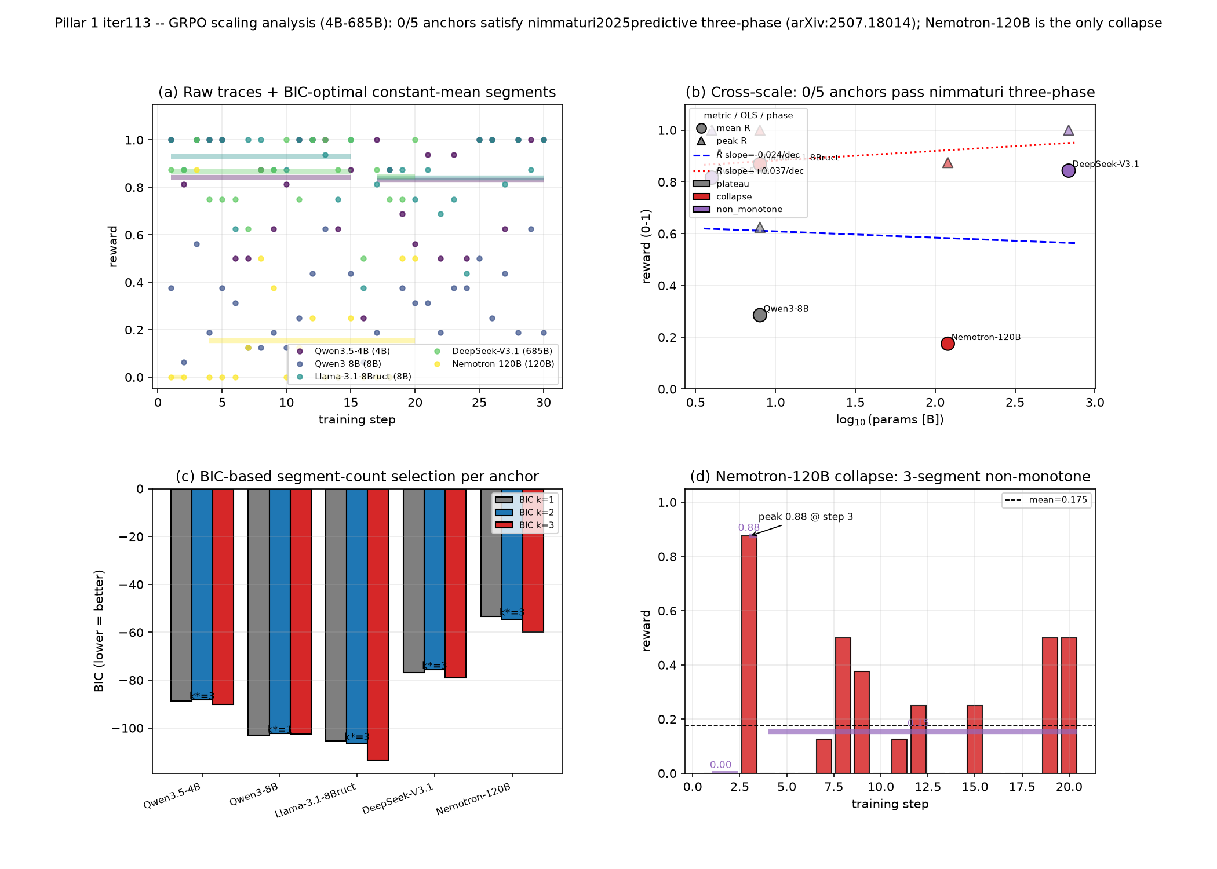
PILLAR / PAPER P1
Result 5 — GRPO Scaling Behavior
Studied across ~2.4 orders of magnitude (0.6B → ~671B) over 70+ runs, 7 libraries, 5 model families.
Central result is a conservative negative: no reliable positive cross-scale slope in mean GRPO reward — flat within (wide) uncertainty.
A clean three-phase saturation law is falsified: only 2 of 12 anchors match; no single saturation exponent is identifiable.
Nemotron-120B is a distinct collapse phase (zero-reward step fraction 0.55 vs ≤ 0.067 elsewhere), not a point on a trend.
Categorical capability structure carries more signal than log₁₀N — a local, stack-conditioned taxonomy, not a Chinchilla power law.
Cross-scale GRPO reward fit (paper/figures/)
Source: paper/sections/p1_abstract.tex; experiment_summary.md size ladder
Tinker RL Lab — M.Tech Final Thesis Review • Arvind C R
12

Slide 13
SEMESTER 4 PAPER SERIES
P1–P8 Contribution Map
# | Title (abbreviated)
P1 | Scaling Laws for GRPO Post-Training: A Cross-Library, Cross-Scale Study
P2 | The Zero-Variance Fraction: A Descriptive Diagnostic for Signal Starvation
P3 | Group Size in GRPO: Contrast Density and the Bridge to DPO
P4 | Length Bias and Held-Out Generalization in GRPO and Dr. GRPO
P5 | Report the Stack, Not the Label: RL-for-LLM Results Are Stack-Conditioned
P6 | GRPO-Registry: A Machine-Readable Catalog of Group-Relative RL Stacks
P7 | From Diagnostic to Controller: Adaptive Group-Size Intervention
P8 | LLM vs. XGBoost in Credit-Card Fraud: Sensor and Scribe, Not Scorer
Eight standalone papers, freshly compiled from canonical LaTeX sources. Map: sem 4 work/EXPERIMENTS.md (paper → source → evidence).
Tinker RL Lab — M.Tech Final Thesis Review • Arvind C R
13

Slide 14
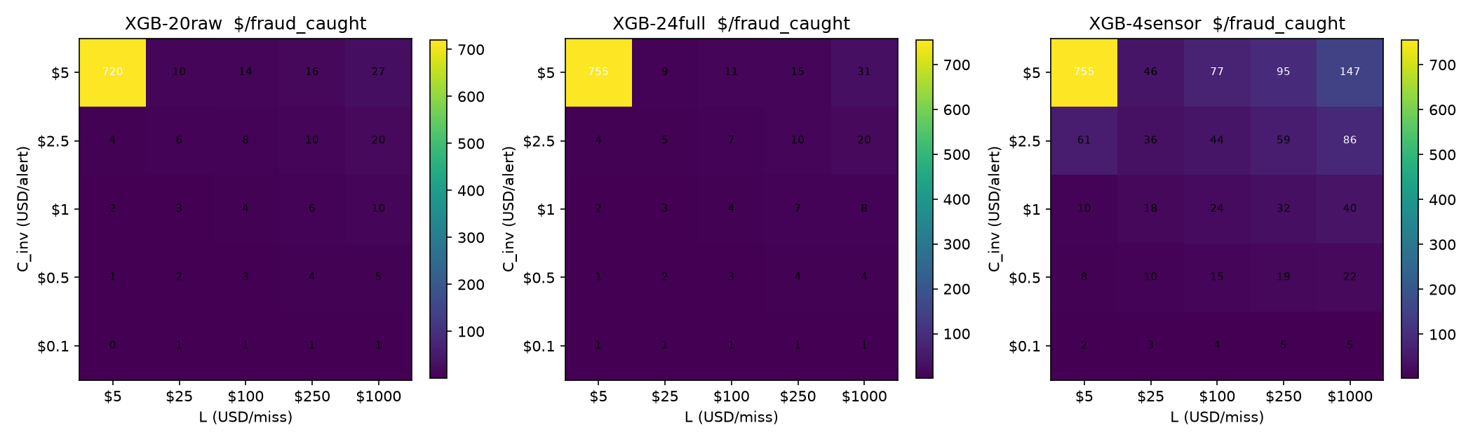
PAPER P8
Applied Study — LLM vs XGBoost Fraud
Head-to-head on a synthetic card-fraud set (50,000 transactions, ~1.4% fraud).
XGBoost: test AUC 0.7955, F1 0.356, precision 0.723, recall 0.236 — trains in 0.5 s.
Qwen3.5-4B SFT scorer: accuracy 0.792 but AUC 0.483 — chance-level ranking. LLM loses the real-time scorer seat.
But “LLM vs XGBoost” is the wrong question. The LLM is a sensor (vision/doc evidence), scribe (SAR / adverse-action narration), and cold-start triage — ~85× cheaper than a human analyst.
Hybrid: LLM = sensor + scribe, XGBoost = scorer.
Cost per fraud caught (paper/figures/)
Source: paper/sections/p8_abstract.tex; xgboost_results.json
Tinker RL Lab — M.Tech Final Thesis Review • Arvind C R
14

Slide 15
Reproducibility & Audit Apparatus
Integrity suite
run_all_audits.py → 13-audit integrity suite
17 standalone *_audit.py checks; each prints METRIC …=N
Covers paper / claim / abstract-scope / held-out / anonymization / submission / blind-review
Multi-seed protocol: canonical 10-seed set
One-command reproduction
Pinned Dockerfile (~6 min cold build)
scripts/smoke_test.sh — <10 min, CPU-only
Headline: GRPO Qwen3-8B GSM8K, peak 62.5%, last-10 34.4% (±5 pts tolerance)
Data pinned by HF revision (GSM8K 7,473 train / 1,319 test)
Full paper reproduction budget: ~446 GPU-h; headline ~5 GPU-h
Sources: run_all_audits.py; REPRODUCE.md; Dockerfile
Tinker RL Lab — M.Tech Final Thesis Review • Arvind C R
15

Slide 16
Publications & Submissions
Semester 3 — Group 6
NeurIPS 2026 main-track submission (anonymized blind-review package)
Blind-review manifest dated April 19, 2026
Frozen at tag capstone-final-2026-04-25 (commit 21a99ef7)
Capstone final report + group benchmark paper
Semester 4 — solo continuation
NeurIPS 2026 workshop submission (16-page anonymous artifact)
“RL-Finetuning Bench: An Exploratory Workshop Artifact for GRPO-Style Post-Training Across Libraries, Models, and Backends”
First committed June 21, 2026 (commit b0ac85bf)
Eight standalone papers P1–P8 + evidence map
Sources: PROJECT_HISTORY.md; sem 4 work/submissions/neurips-workshop/README.md
Tinker RL Lab — M.Tech Final Thesis Review • Arvind C R
16

Slide 17
Demo Pointer
Executed demo notebook: demo_recording/thesis_demo.ipynb — 11 cells, all real outputs (results tables, ZVF, group-size, P8 metrics); HTML export + recorded walkthrough thesis_demo.mp4.
Live HuggingFace Space (pre-computed, CPU-only): arvindcr4-tinkerrl-bench-demo.hf.space
Four tabs: tool-use comparison · ZVF diagnostic · team artifacts · headline numbers.
Phase-1 defense demo runbook: submission/demo/demo.sh + reports/esa_phase1/CODE_WALKTHROUGH.md (DEMO STATUS: PASS).
Headline shown live: tool-call JSON validity 0% → 92% after SFT+GRPO.
Sources: demo_recording/thesis_demo.ipynb; reports/esa_phase1/CODE_WALKTHROUGH.md
Tinker RL Lab — M.Tech Final Thesis Review • Arvind C R
17

Slide 18
Semester 3 vs Semester 4 Ownership
 | Semester 3 — Group 6 | Semester 4 — Solo
Team | Six students; guides Paduri & Darapaneni | Arvind C R; guide Ramesh Prakash Guledgudd
Deliverables | Lit foundation, multi-framework env, first experiments, group paper, NeurIPS main-track | P1–P8 papers, NeurIPS workshop, expanded diagnostics & controllers, fraud study
Boundary | Frozen: tag capstone-final-2026-04-25 (21a99ef7) | Starts after boundary; workshop from June 21, 2026
Evidence | Immutable historical deliverables | 206 recorded analysis iterations; new audits & prototypes
Shared code stays at repo root; the two semester folders are curated academic views. Source: PROJECT_HISTORY.md; sem 4 work/README.md
Tinker RL Lab — M.Tech Final Thesis Review • Arvind C R
18

Slide 19
Limitations & Future Work
Limitations
Single-seed Tinker runs; no variance/significance on Tinker data
Short horizons (30–50 steps) — no asymptotic claims
Closed Tinker internals: results measure the platform, not the algorithm
Saturated tasks compress variance (G-equivalence is a null, not proof)
Exploratory, not pre-registered; narrow benchmark coverage
Future work
Repeat ZVF / group-size on harder, non-saturating tasks
Direct gradient-vector validation of the DPO-like interpretation
Full-FT vs LoRA re-runs across every baseline library
Exhaustive LR × rank × batch × G sweeps
P7 adaptive ZVF controller: from diagnostic to intervention
Source: LIMITATIONS_AND_IMPACT.md §7
Tinker RL Lab — M.Tech Final Thesis Review • Arvind C R
19

Slide 20
Conclusions
A multi-framework GRPO benchmark (6 backends, 44+ curated runs, 70+ across the roster) that runs identical workloads and reports the stack.
Four de-confound pillars show “GRPO” gains are stack- and model-conditioned: same-stack PPO≡GRPO (p=0.76).
ZVF (and gradient utilization = 1−ZVF) is a portable diagnostic for signal starvation; group size is a preference-density dial.
Honest held-out negative: GRPO adds only +1.3 pts on GSM8K (p=0.26) — it surfaces capability more than it creates it.
Reproducibility-first: 13-audit suite, Docker, REPRODUCE.md, and eight papers P1–P8 + a NeurIPS workshop artifact.
Tinker RL Lab — M.Tech Final Thesis Review • Arvind C R
20

Slide 21
Thank You
Questions & Discussion
Arvind C R · SRN <SRN> · M.Tech Data Science & AI, PES University
Guide: Ramesh Prakash Guledgudd · github.com/arvindcr4/tinker-rl-lab

